Slide 1
Healthy Churches guard the gospel
1 Timothy 1:1-11
Preached by Dr. Jim Harmeling at Crossroads International Church Singapore • cicfamily.com Uploaded by Dr. Rick Griffith • Singapore Bible College Thousands of files in 49 languages for free at BibleStudyDownloads.org

Slide 3
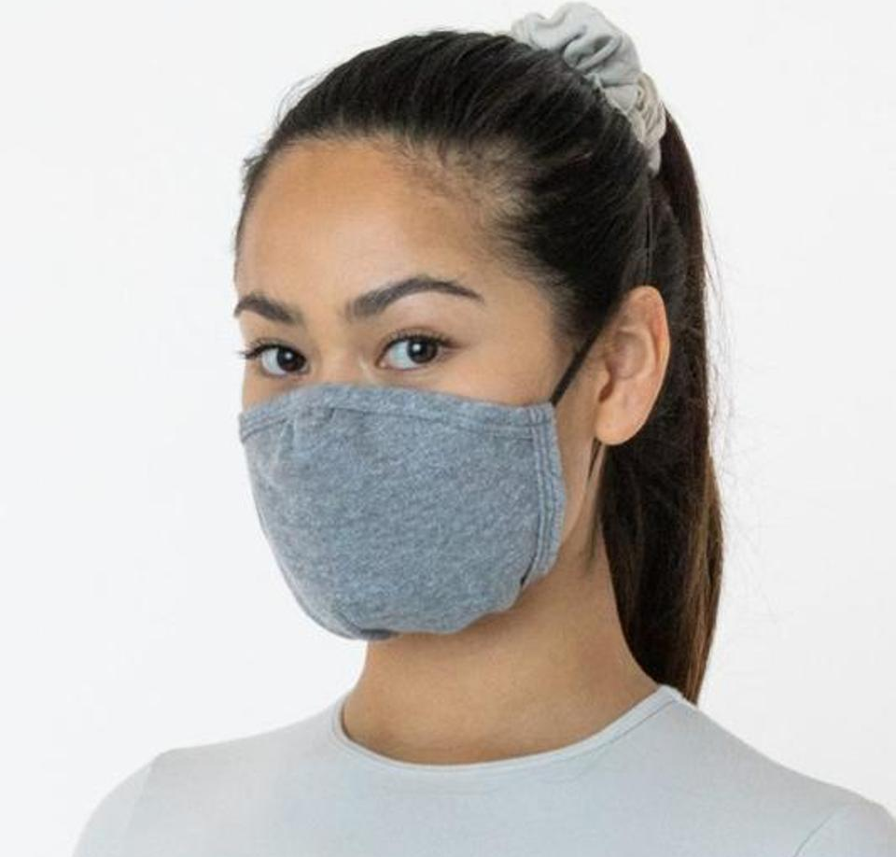
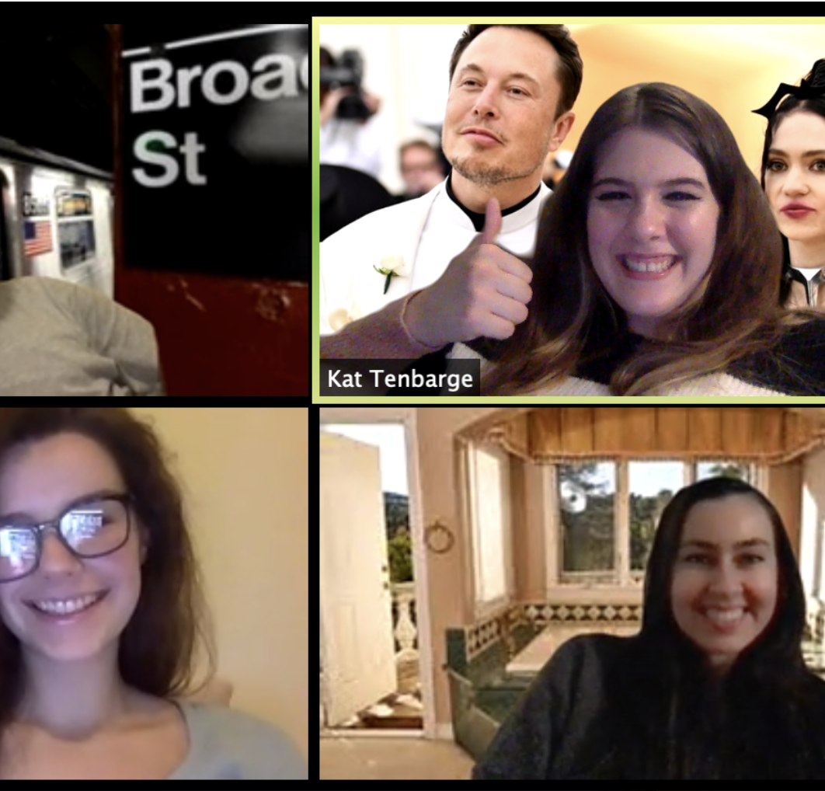
How do you stay healthy?

Slide 4
Healthy Church Life
Studies in 1 Timothy

Slide 5
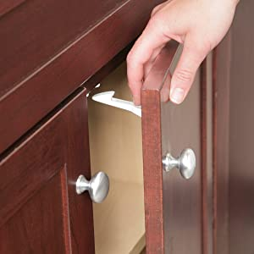
Kid Proofing the house

Slide 6
1 – Healthy Churches guard the gospel
2 – Healthy Churches pray
3 – Healthy Churches develop godly leaders
4 – Healthy Churches are well taught
5 – Healthy Churches care for each other
6 – Healthy Churches avoid worldliness

Slide 7
Healthy Churches guard the gospel
1 Timothy 1:1-11

Slide 8
Acts 20:29-31
²⁹ I know that after my departure fierce wolves will come in among you, not sparing the flock; ³⁰ and from among your own selves will arise men speaking twisted things,
to draw away the disciples after them.
³¹ Therefore be alert, remembering that for
three years I did not cease night or day to
admonish every one with tears.

Slide 9
Recognize the authority of the gospel (vs. 1-2)
Ephesians 2:19-20
¹⁹ So then you are no longer strangers and aliens, but you are fellow citizens with the saints and members of the household of God, ²⁰ built on the foundation of the apostles and prophets, Christ Jesus himself being the cornerstone

Slide 10
Recognize the authority of the gospel (vs. 1-2)
1 Corinthians 9:1
Am I not free? Am I not an apostle? Have I not seen Jesus our Lord? Are not you my workmanship in the Lord?
2 Corinthians 12:12
The signs of a true apostle were performed among you with utmost patience, with signs and wonders and mighty works.

Slide 11
Recognize the authority of the gospel (vs. 1-2)
Do not get distracted from the goal of the gospel (vs. 3-5)

Slide 12
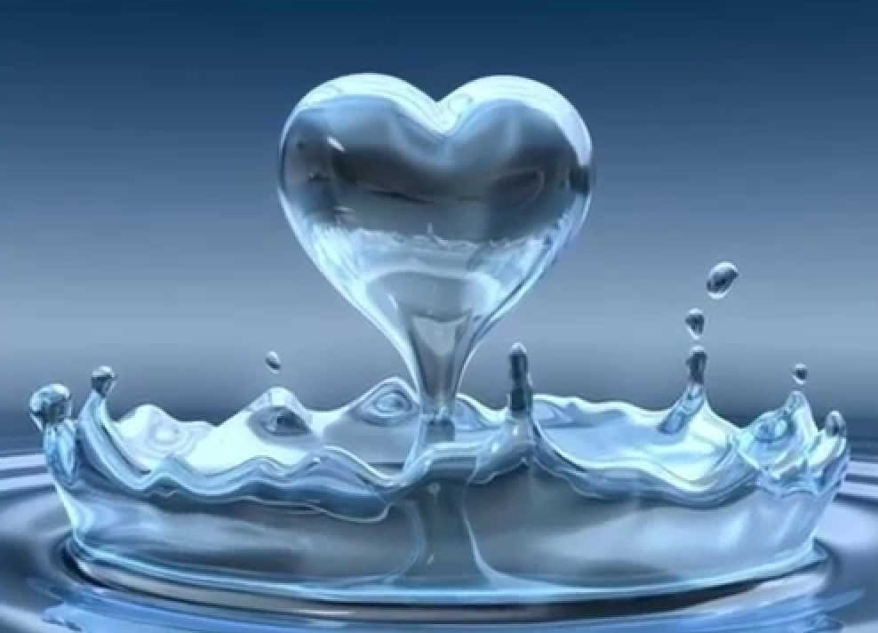
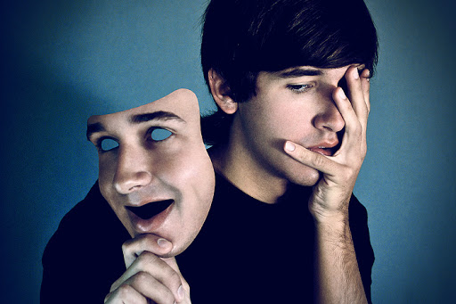
Clean heart
The qualities of love in a healthy disciple of Christ
Good conscience
Sincere faith

Slide 13
The 72 Names of God
Kabbalah.com
The 72 Names are 72 three-letter combinations of Hebrew letters, each combination channeling its unique energy from the Upper Worlds into our world through the letters themselves. We can connect with these letters simply by passing our eyes over them with the conscious intent of connecting to their energy.
At the Kabbalah Centre, we teach that any person can use these Names as a spiritual tool to connect with the spark of Divine Essence within and to make transformations at the seed level—the level of consciousness.

Slide 14
Recognize the authority of the gospel (vs. 1-2)
Do not get distracted from the goal of the gospel (vs. 3-5)
Retain the Law in the gospel (vs. 6-11)

Slide 15
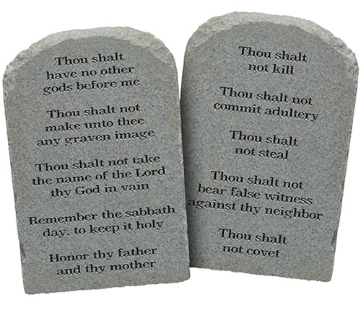
God’s Law
God’s standard of holiness and righteous living (Rom 7:12)
It requires internal and external adherence (Matt 5:17-30)
It reveals how sinful we are (Rom 3:20)
It leads us to Christ for forgiveness (Galatians 3:23-27)

Slide 17
NT Preaching • BibleStudyDownloads.org
Get this presentation for free!

